Slide 1
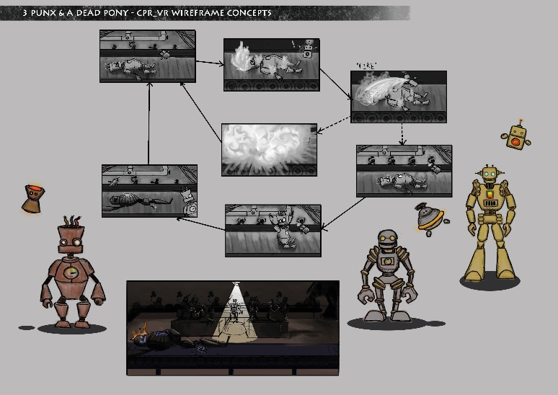
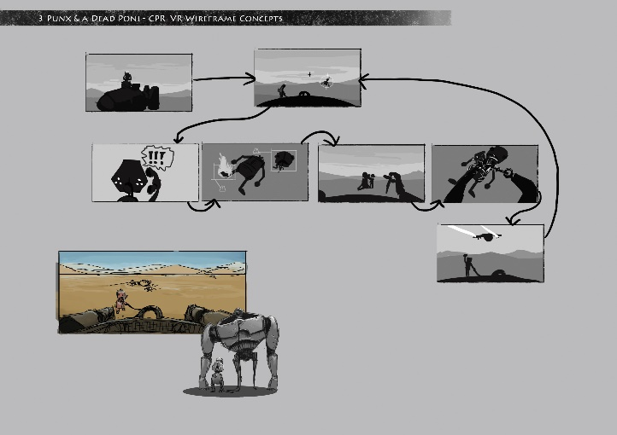
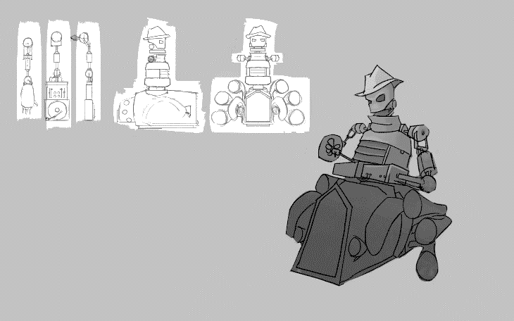
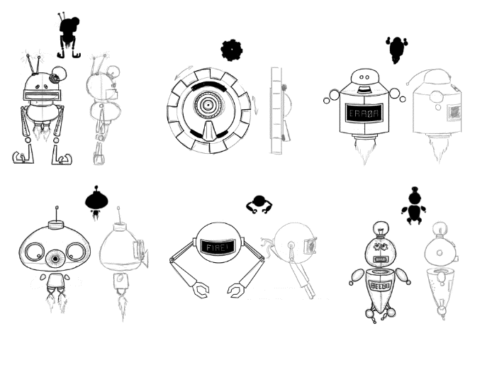
The Factory Groove
Sophie Walker, Ron Dekker, Jesse Deerenberg
Introduction
STARK Learning approached us to create an applied game for training CPR skills in a classroom setting. A key requirement for this project was to use the Oculus Rift. Our goal was to create a fun yet skill endorsing experience for learners.
Design Challenges
We wanted to translate the stress and distractions a person could experience while performing CPR, without making a simulation or drifting into a bleak setting. The aim was to address all required physical and mental skills in an unrelated setting. As the player would have all the theoretical briefing beforehand, we felt that our approach would allow them a different way to memorise the required routines and skills.
Technical Challenges
To properly simulate the physical movement when performing CPR we needed additional hardware. We tried the Arduino but could not find a pressure sensor that was accurate enough for our purposes so we had to find another input. An additional difficulty was the voice recognition which we wanted to implement.

Slide 2
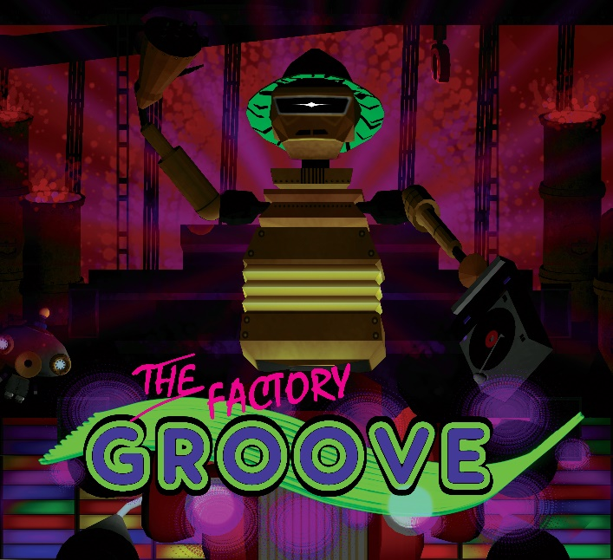
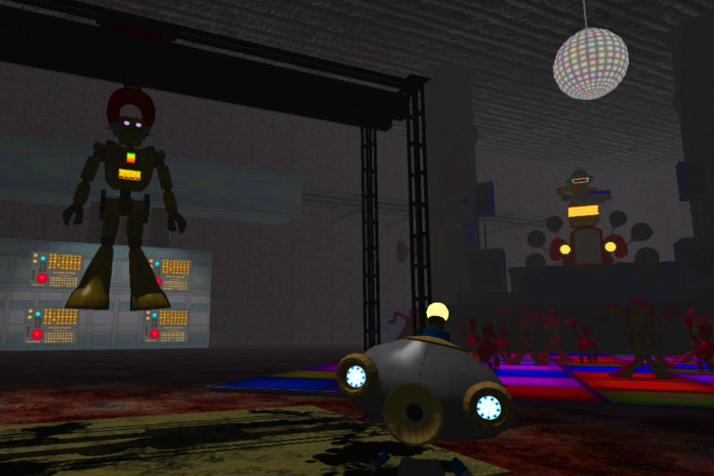
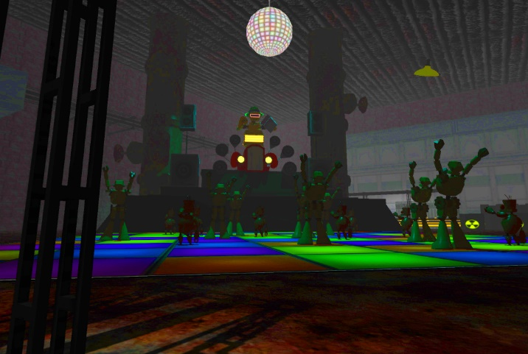
Results
Finally we came up with the idea of a robot factory where the player has to wind up broken robots. In order to succeed they have to first eliminate external hazards on the robots and then adhere to the specific CPR rhythm, which in our case is provided by an 80’s themed dance party. During their performance the player is guided and assessed by a little helper bot and punished by an angry DJ.
The robot theme instantly took away from the realism and the dance party allowed us to create a silly atmosphere. With the helper robot being a distraction and guide at the same time, we managed to put the player into a stressful situation. In case of failure the robots will explode, when fixed they will start dancing and one after the other fill up the stage.
On a technical level we decided to use a Wii board as input. In order for voice recognition to work, we created a separate program alongside the game that uses the built in voice recognition of Windows.
Discussion
It turned out that player acceleration in virtual reality can make people feel nauseous, therefore it is be more beneficial to have a static set up or constant movement.
Another thing to take into consideration when it comes to player nausea is the FPS count. When the framerate drops too low, players will start feeling unwell. This results in some restrictions on the visual end.

